Slide 1
Image Features
Deep Learning and Image Processing

Slide 2
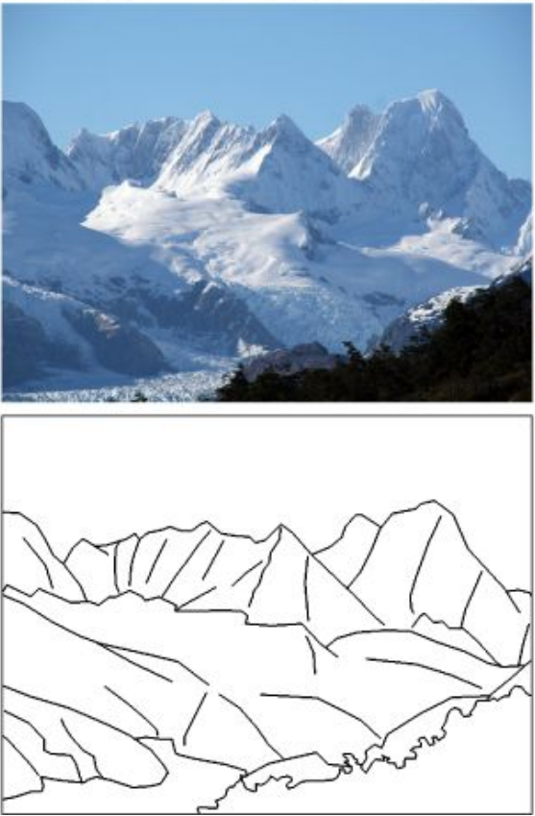
From Edges to Boundaries
edge: image location of rapid change in intensity
(caused by discontinuities of surface, depth, or illumination)
edges encode most shape and semantic information
to detect edge pixels: image derivatives (see sharpening filters)
follow-up steps:
edge linking (connect edge pixels to edge segments)
boundary detection
non-semantic image segmentation and object recognition

Slide 3
Canny Edge Detector

Slide 4
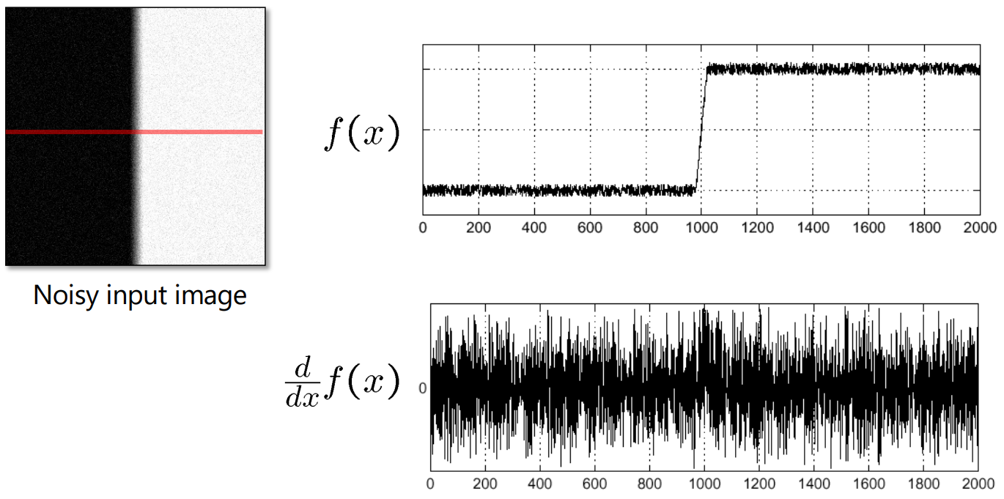
Noise Complications for Edge Detection
image derivatives accentuate high frequencies (high-pass filter)
→ amplification of noise (proportion of noise to signal larger at high frequencies)
intensity of pixels

Slide 5
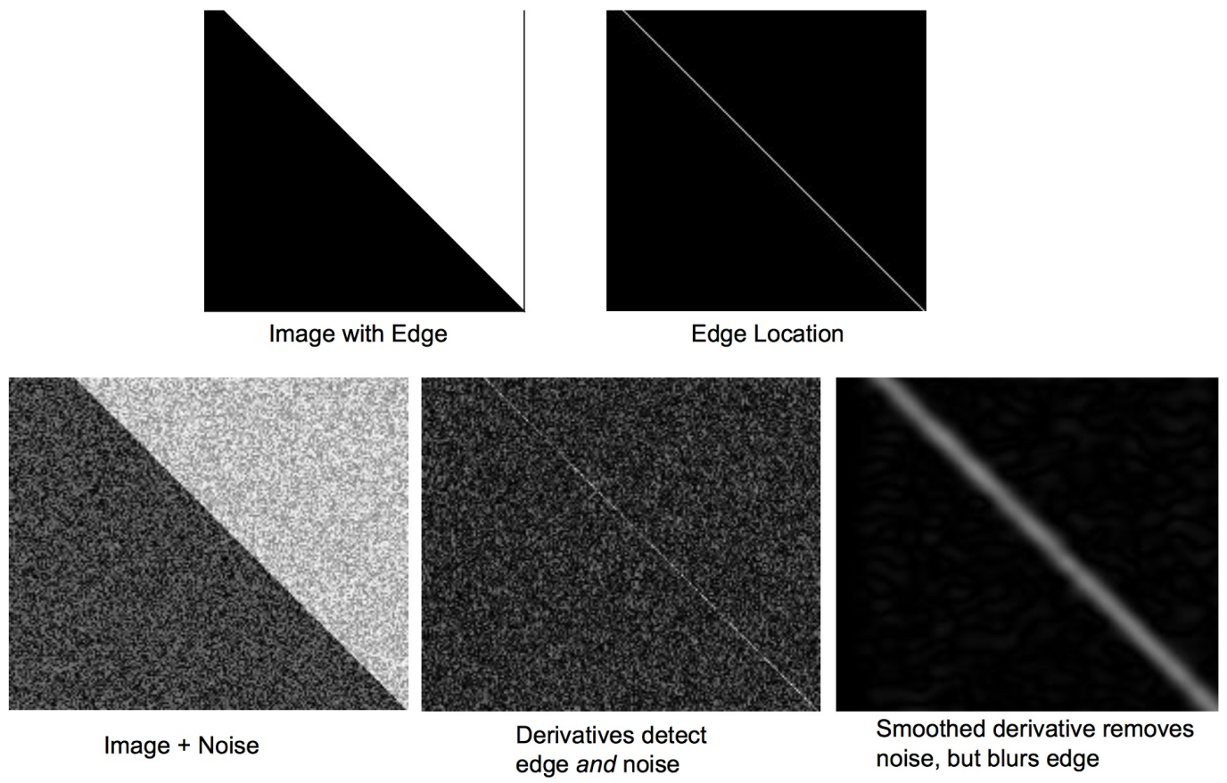
Need for Band-Pass Filter
idea:
blurring (low-pass filter) before derivation (high-pass filter)
edge detector should be isotropic: need for circularly symmetric smoothing filter
→ Gaussian is only separable one

Slide 6
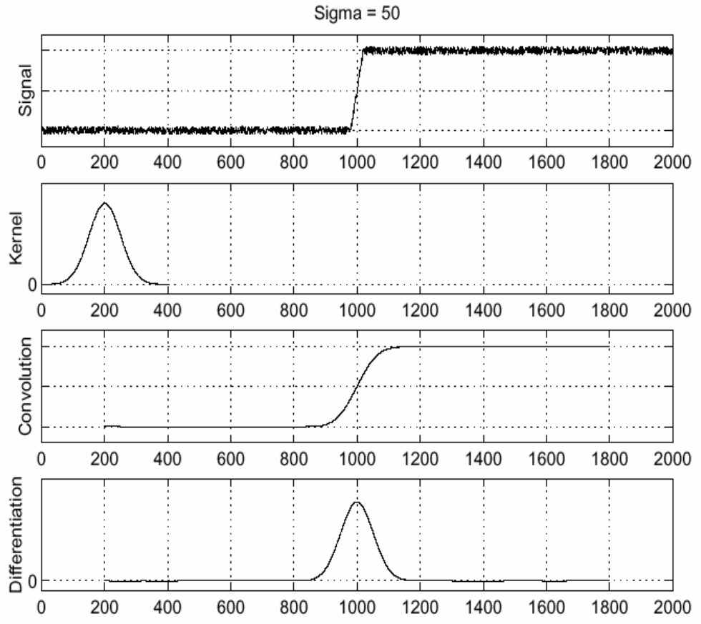
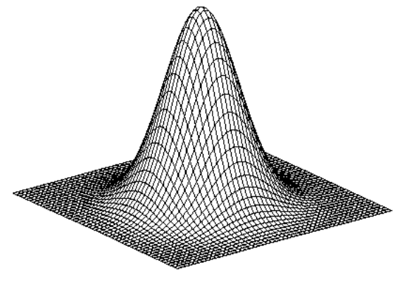
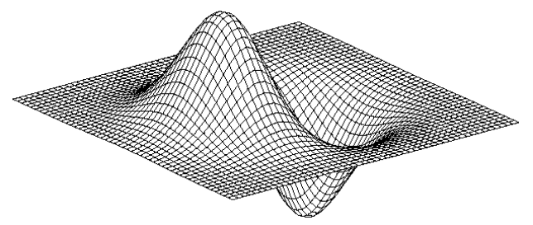
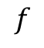
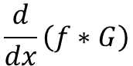
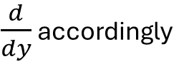
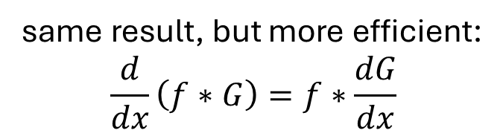
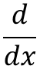
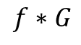

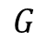
Gradient with Gaussian Smoothing
same result, but more efficient:
$$\frac{d}{dx}\left(f∗G\right)=f∗\frac{dG}{dx}$$
$$f$$
$$G$$
$$\frac{d}{dx}$$
$$=$$
$$f∗G$$
$\frac{d}{dy}$ accordingly
$$\frac{d}{dx}\left(f∗G\right)$$
to find edges, look for peaks in first-order derivatives
→

Slide 7
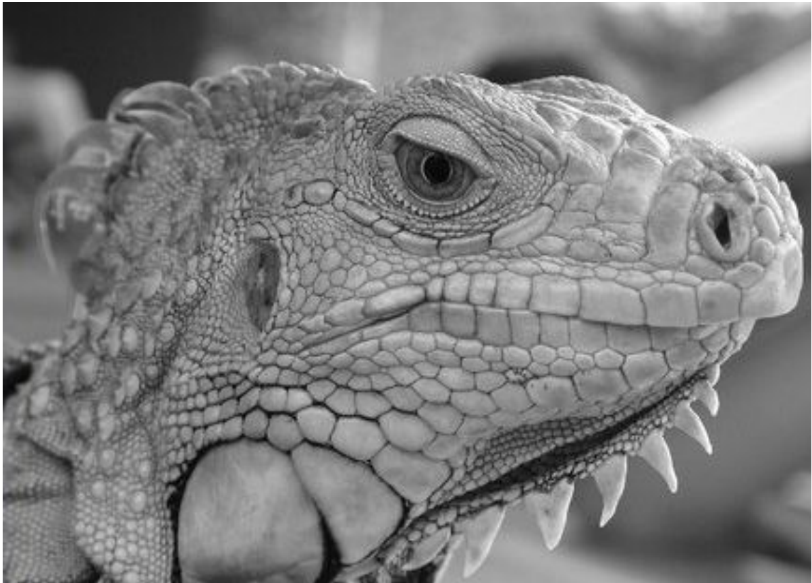
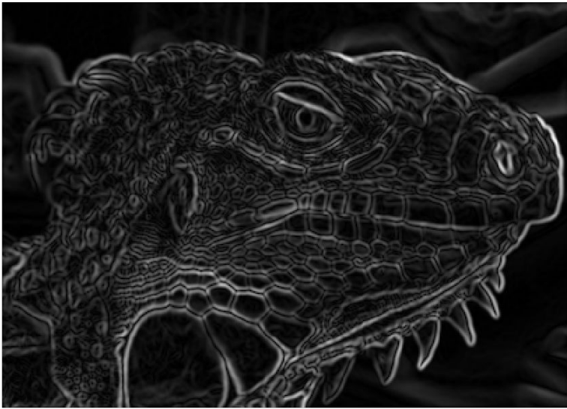
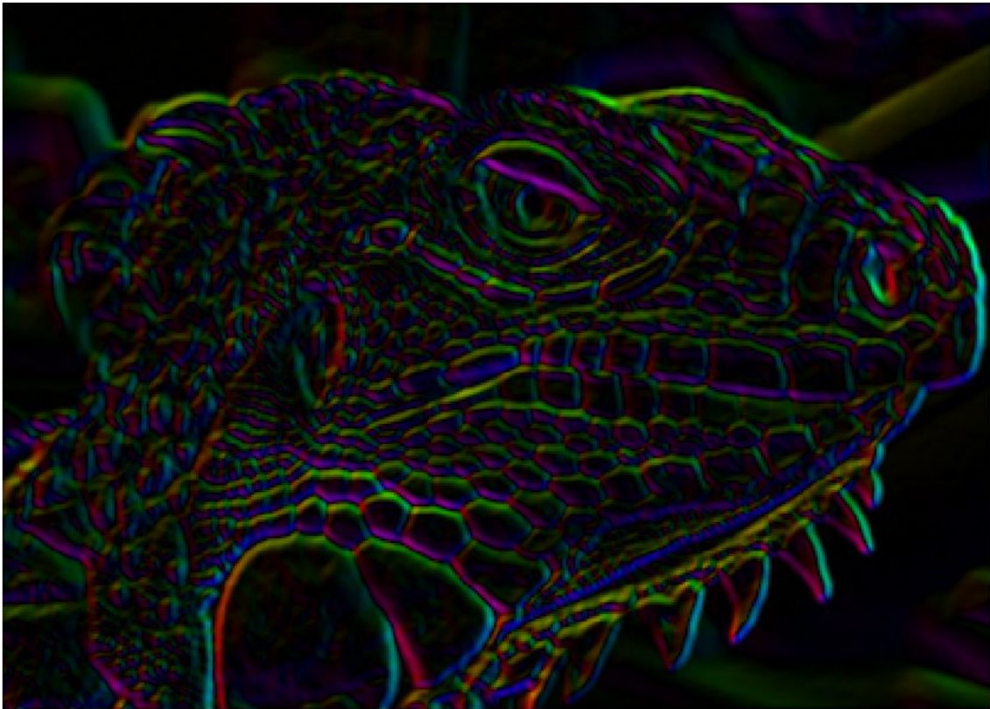
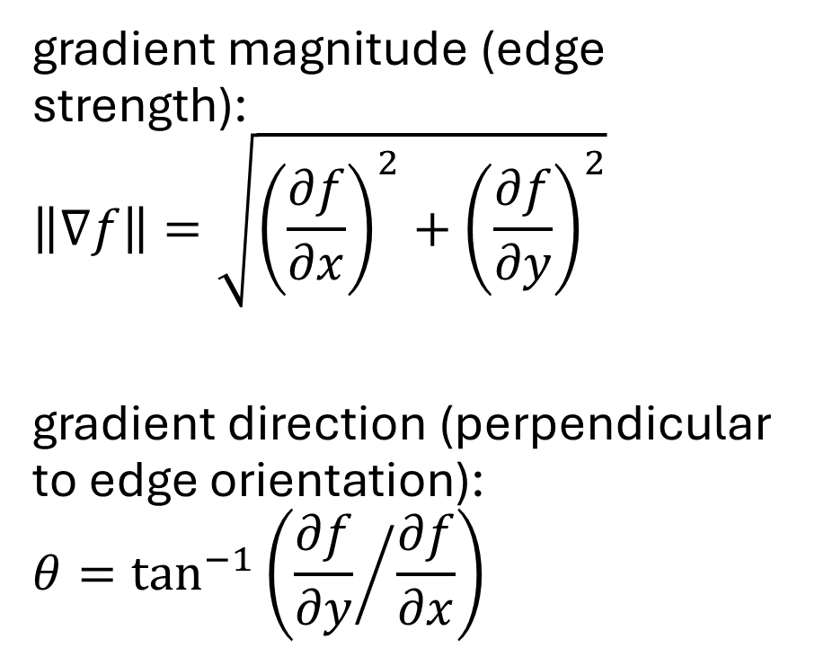
Edge Strength and Orientation
gradient magnitude (edge strength):
$$\left\|∇f\right\|=\sqrt{{\left(\frac{∂f}{∂x}\right)}^{2}+{\left(\frac{∂f}{∂y}\right)}^{2}}$$
gradient direction (perpendicular to edge orientation):
$$θ=\tan^{−1}\left({\frac{∂f}{∂y}}/{\frac{∂f}{∂x}}\right)$$

Slide 8
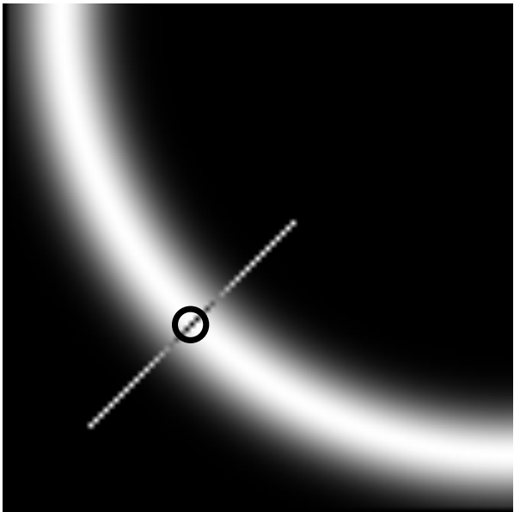
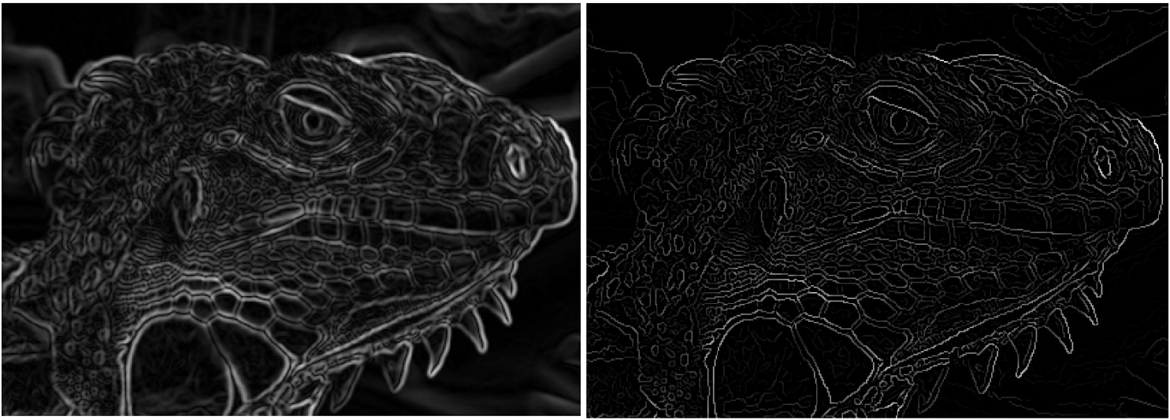
Non-Maximum Suppression
only detect as edge pixel if local maximum along gradient direction (using interpolation between pixels)
→ thin the edges
(can be done with Laplacian zero-crossings)
gradient magnitude:
before
after

Slide 9
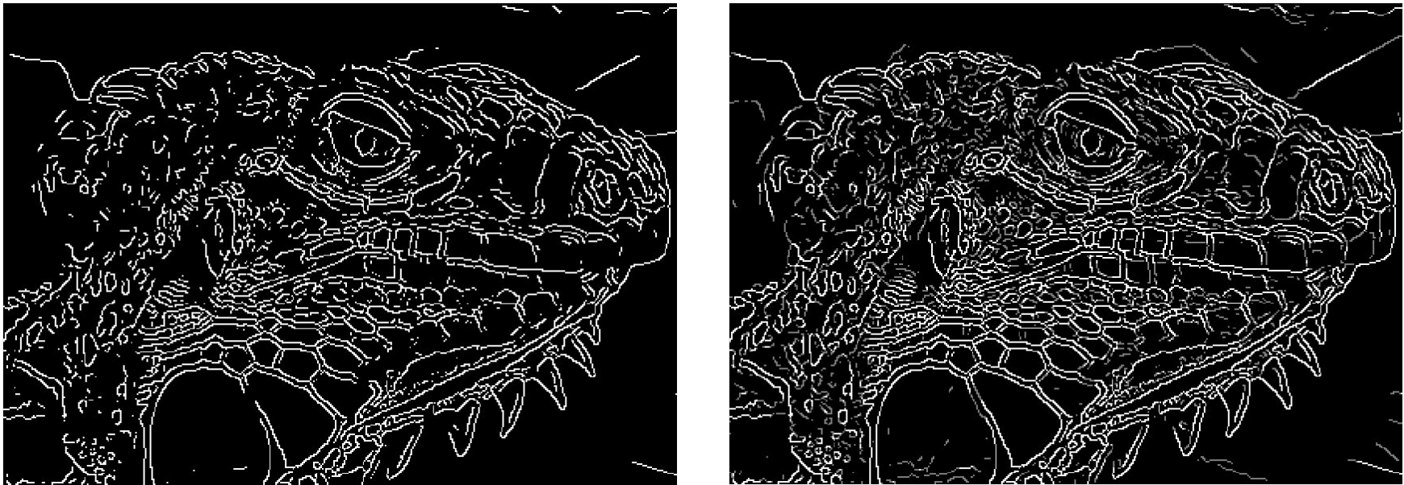
Thresholding
still need to decide for each pixel if edge pixel or not
→ generate binary image by thresholding gradient magnitudes
problem: thresholding can lead to many disconnected edges
also, choice of threshold value can be difficult:
high threshold:
few edges
low threshold:
many edges

Slide 10
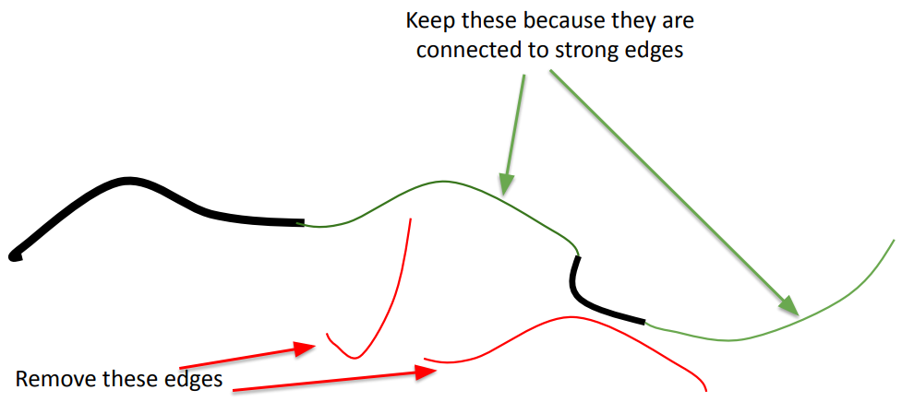
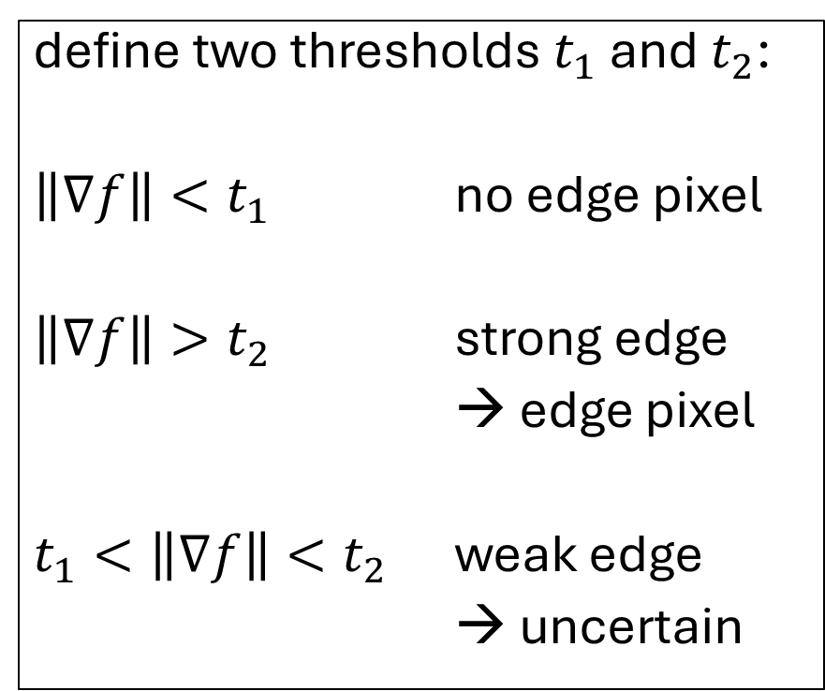
Hysteresis: Edge Tracking
define two thresholds $t_{1}$ and $t_{2}$:
$\left\|∇f\right\|<t_{1}$ no edge pixel
$\left\|∇f\right\|>t_{2}$ strong edge
→ edge pixel
$t_{1}<\left\|∇f\right\|<t_{2}$ weak edge
→ uncertain
for weak edges, decide on neighborhood:
red and green:
connected, weak edges
strong edges

Slide 11
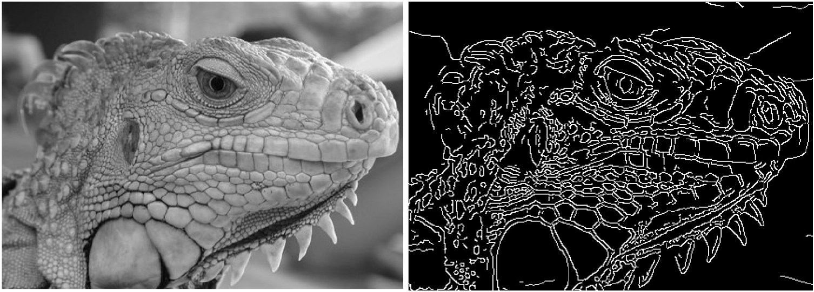
Putting It Together: Canny Edge Detector
smoothing by Gaussian filter
calculate magnitude and direction of gradient image
non-maximum suppression (reduce to single-pixel edges)
hysteresis (binary edge image with linked edge pixels)

Slide 12
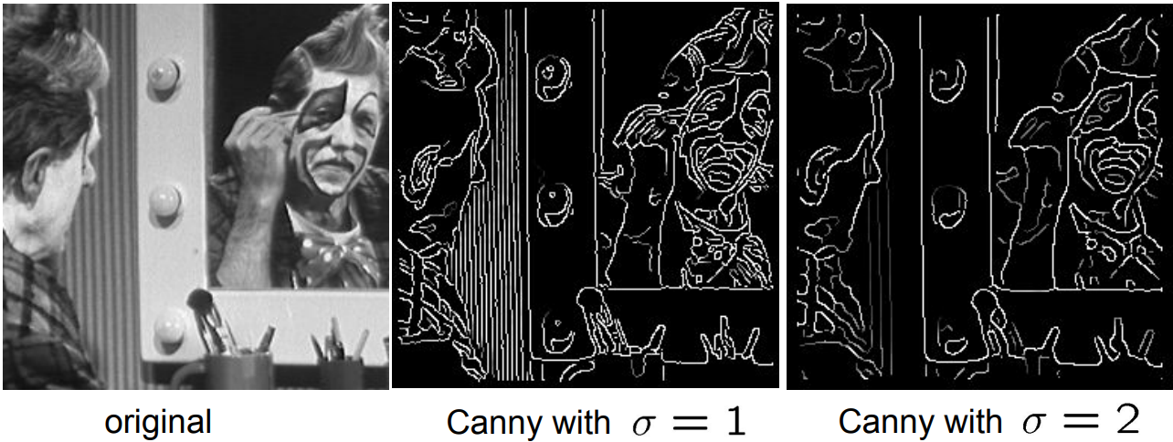
Scale Space
besides threshold values, one more important parameter in Canny edge detector: used standard deviation of Gaussian smoothing filter
broad Gaussians detects large-scale edges
narrow Gaussians detect fine edges
→ can be combined to detect and select edges at different scales

Slide 13
Marr-Hildreth Edge Detector

Slide 14
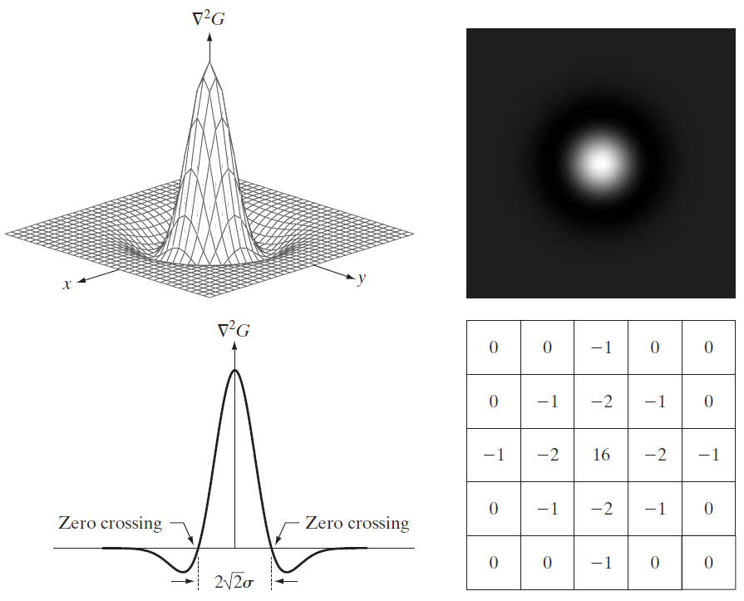
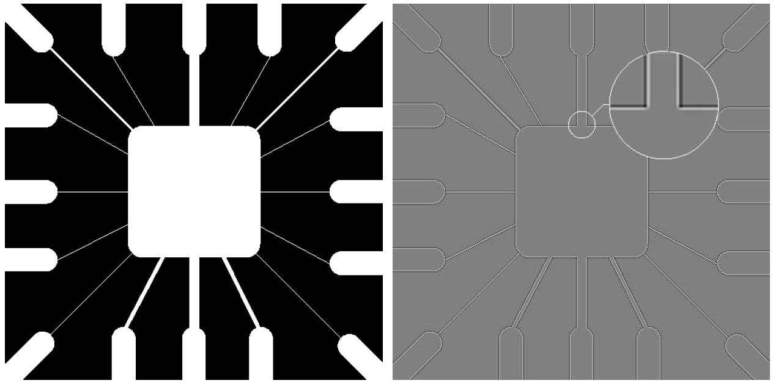
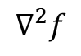
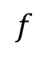
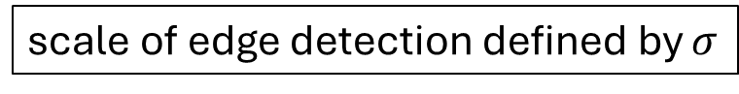

Alternative: Laplacian of Gaussian (LoG)
use same idea of smoothing by Gaussian filter before Laplacian
$$∇^{2}\left(f∗G\right)=f∗∇^{2}G$$
Laplacian:
zero-crossings at edges
shown here: negative LoG
approximated LoG filter
$$f$$
$$∇^{2}f$$
scale of edge detection defined by $σ$

Slide 15
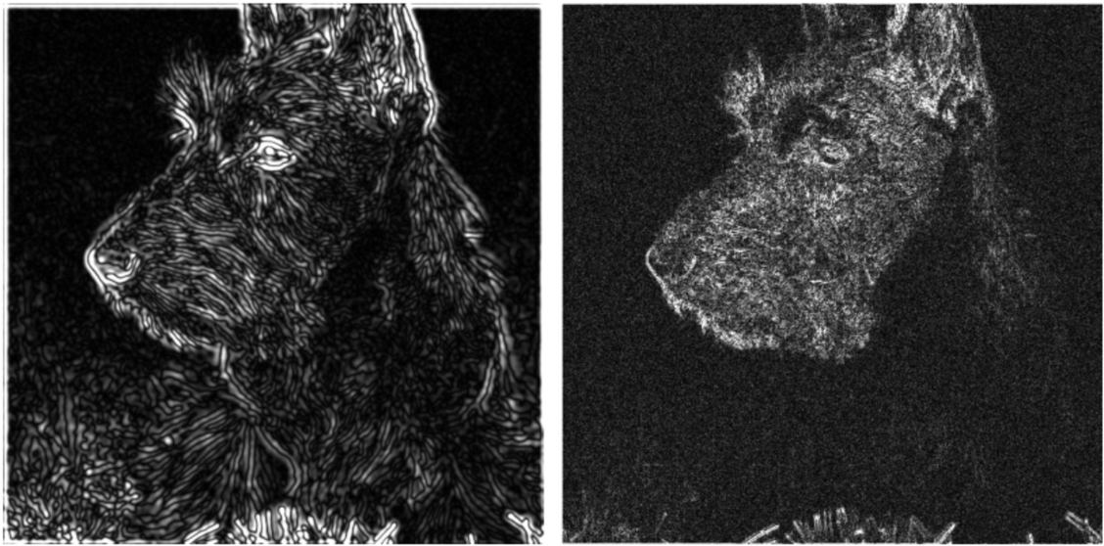
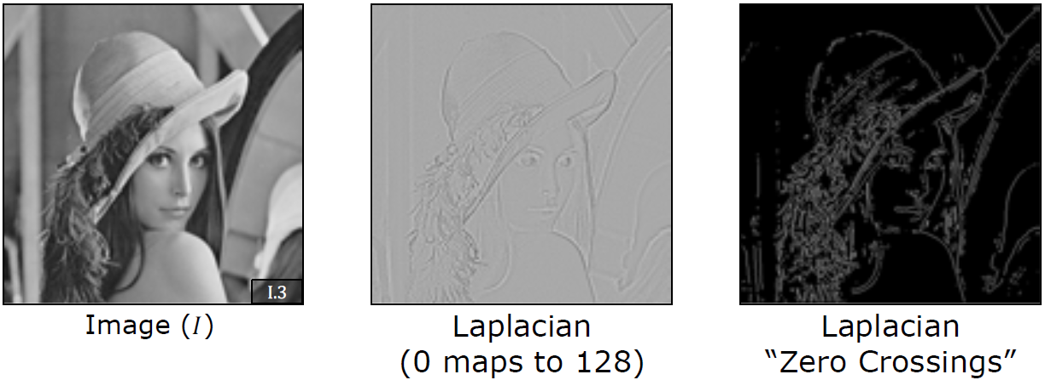
Zero-Crossings for Edge Detection
effect of Gaussian smoothing:
LoG
Laplacian
use zero-crossings for edge detection
(instead of maxima for gradient)
zero-crossings also thresholded:

Slide 16
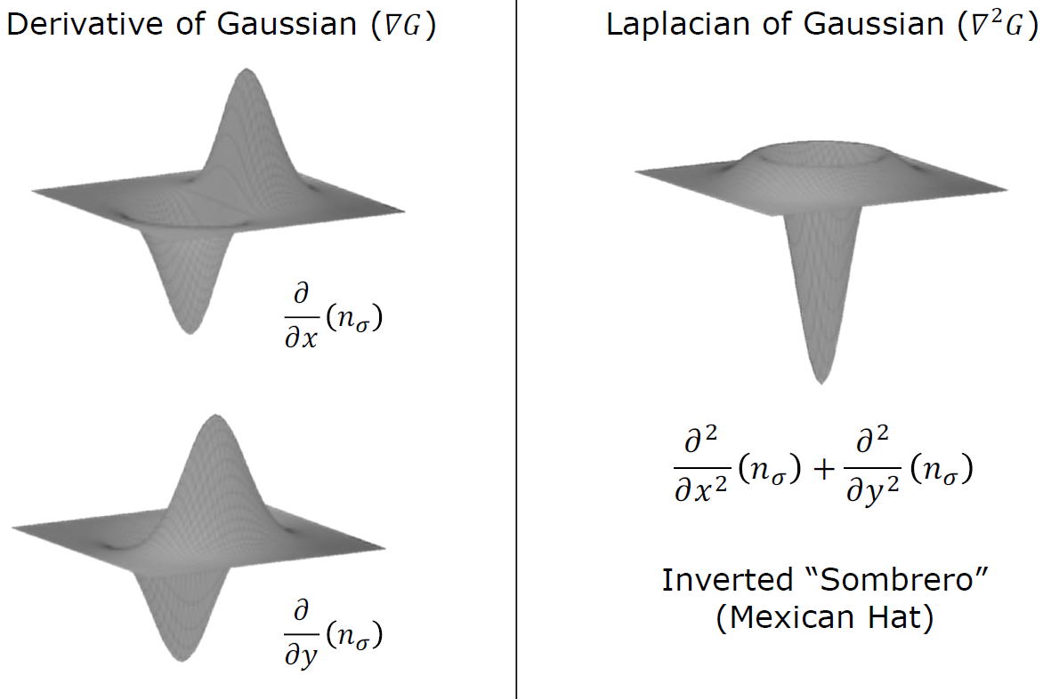
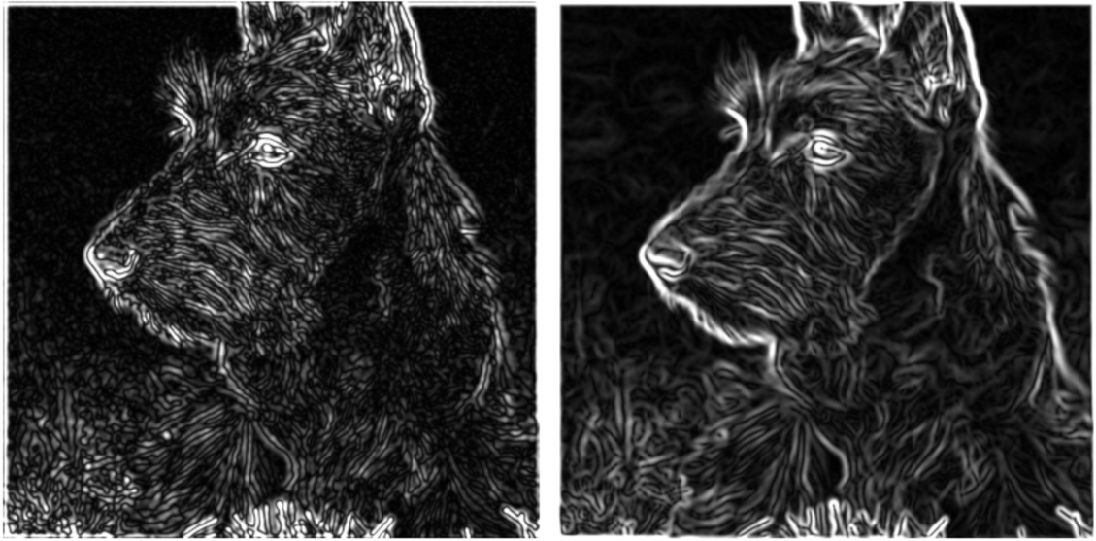
LoG vs Derivative of Gaussian
LoG
derivative of Gaussian
Laplacian provides only edge location, no strength or direction
but requires only one convolution instead of two

Slide 17
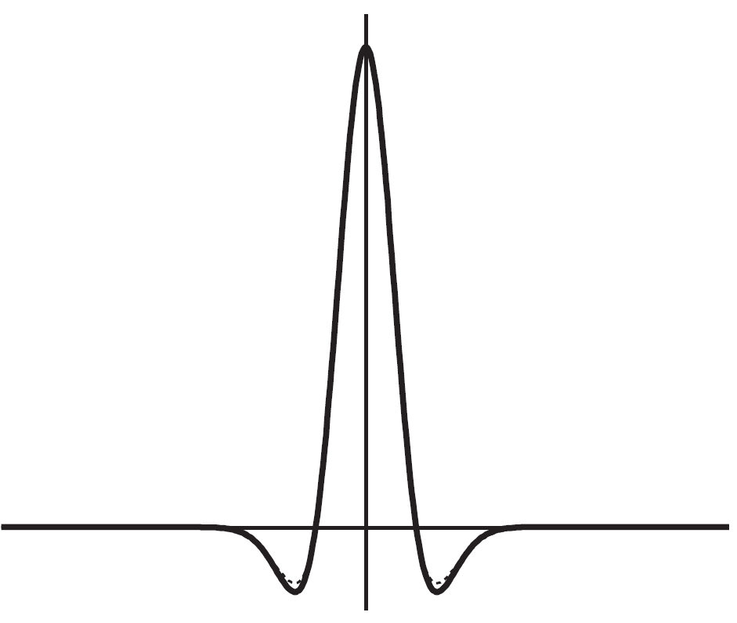
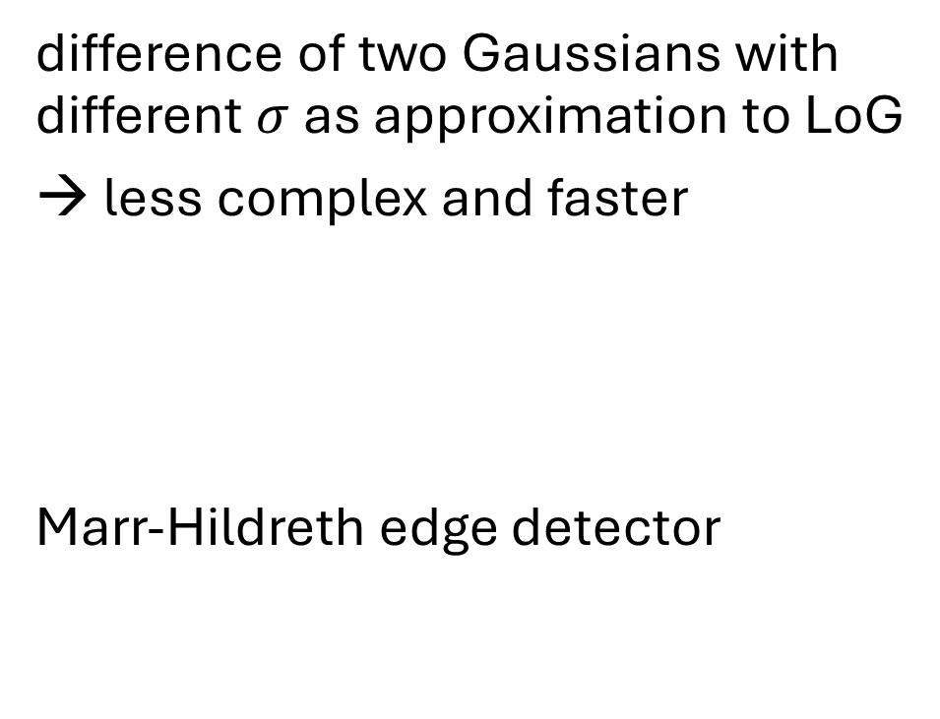
Difference of Gaussians (DoG)
difference of two Gaussians with different $σ$ as approximation to LoG
→ less complex and faster
Marr-Hildreth edge detector
solid: LoG
dashed: DoG
ratio here 1.6:1

Slide 18
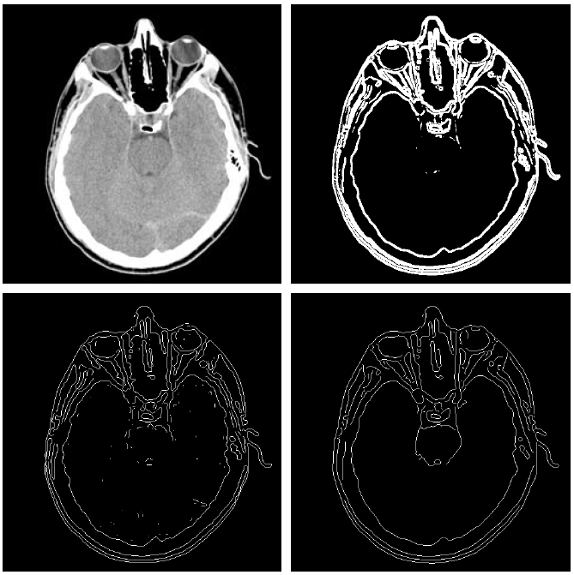
Comparison of Edge Detectors
thresholded gradient of smoothed image
original
Marr-Hildreth edge detector
Canny edge detector

Slide 19
Local Features

Slide 20
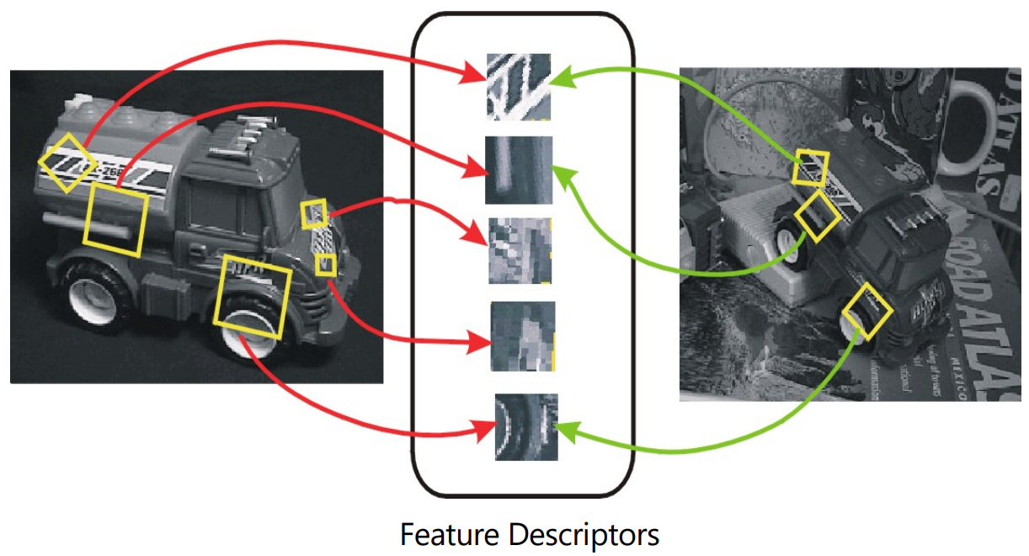
Keypoint Detection & Matching
different stages:
feature detection: search for distinguishing keypoints (aka interest points) in images
feature description: construct (invariant) descriptors/features from regions (pixel patches) around detected keypoint locations
feature matching: search for matching keypoints (correspondences) in other images

Slide 21
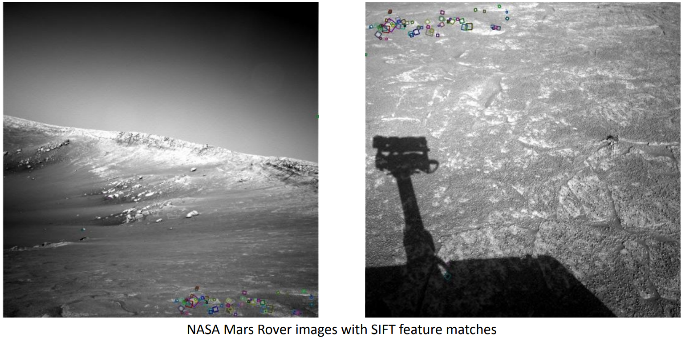
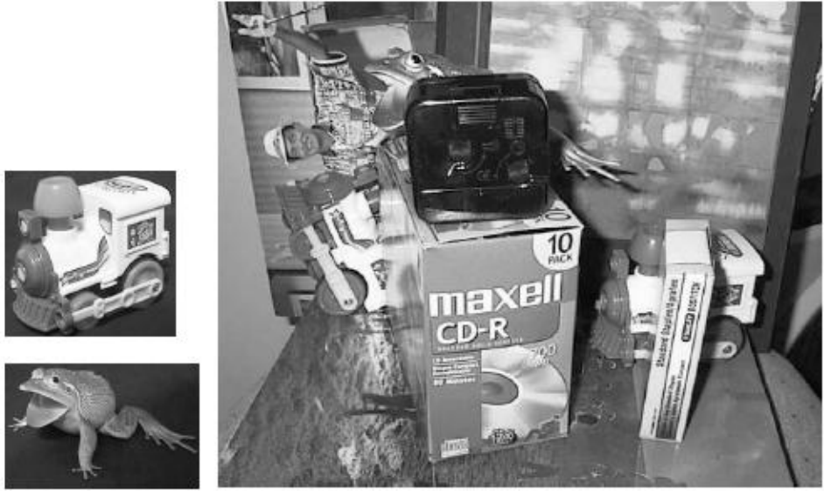
Why Local Keypoint Features for Instance Recognition?
often non-obvious shapes
at different scales, under perspective changes and with partial observability
→ matching predefined shapes or large patches very difficult

Slide 22
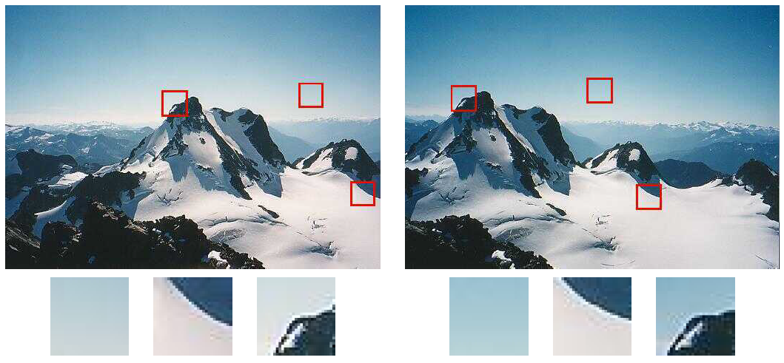
Good and Bad Keypoints
flat regions cannot be localized
edges are difficult to localize
corners are interesting candidates

Slide 23
Feature Detection

Slide 24
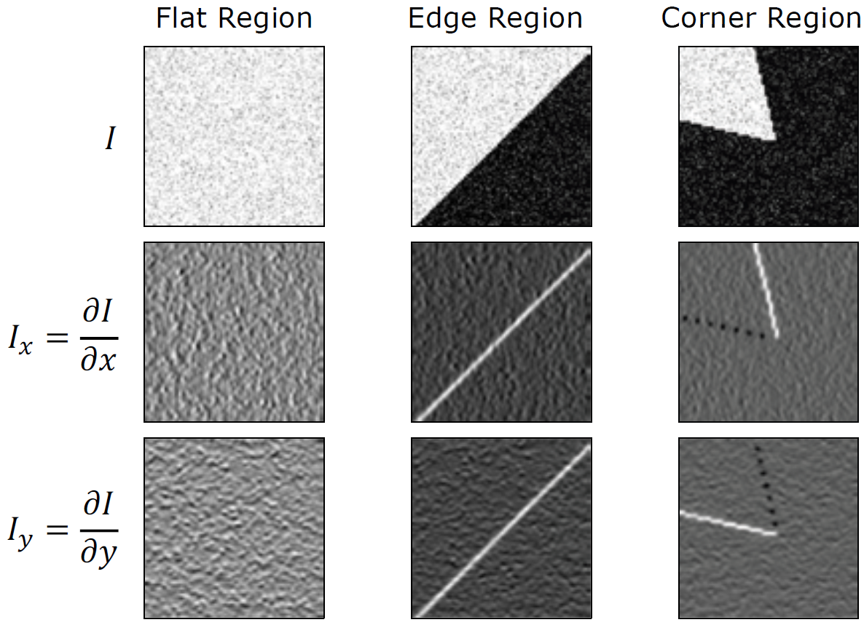
Harris Corner Detector
define a small window and shift over image
for each region calculate image gradients

Slide 25
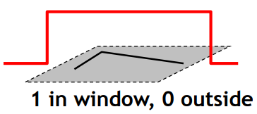
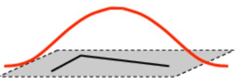
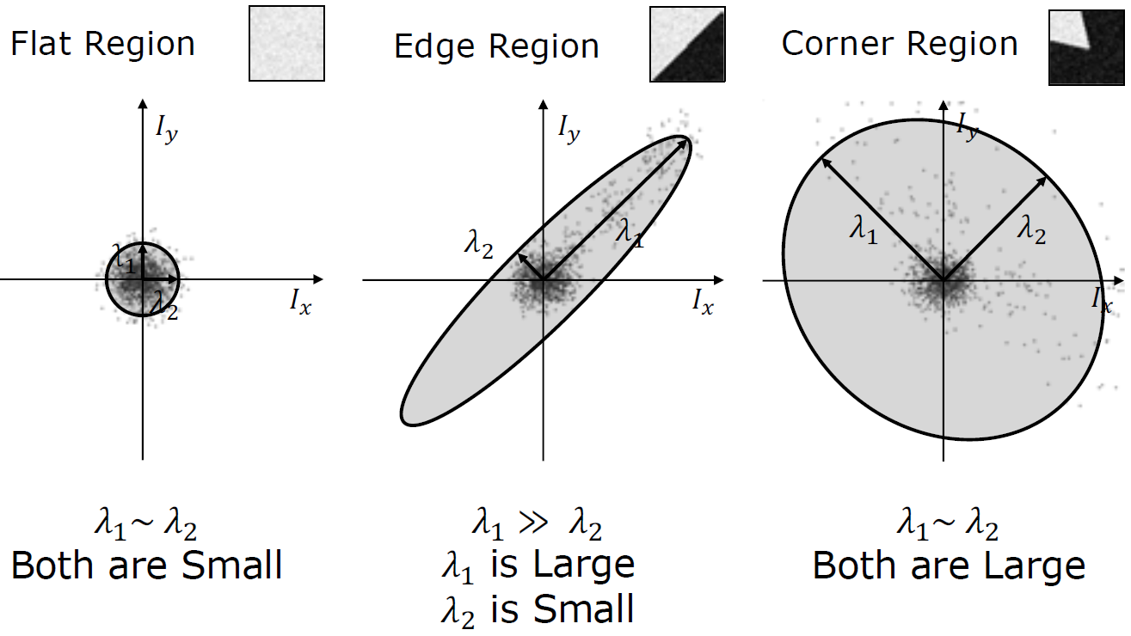
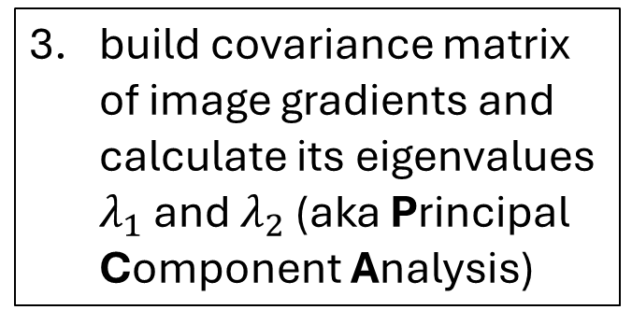
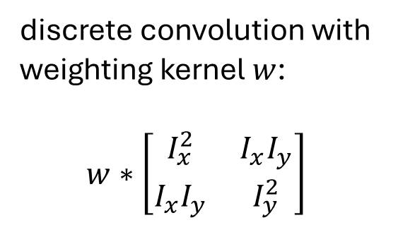
discrete convolution with weighting kernel $w$:
$$w∗\left[\begin{matrix}I_{x}^{2} & I_{x}I_{y} \\ I_{x}I_{y} & I_{y}^{2}\end{matrix}\right]$$
directions of maximum variance
or better: Gaussian
→ rotation invariant
build covariance matrix of image gradients and calculate its eigenvalues $λ_{1}$ and $λ_{2}$ (aka Principal Component Analysis)

Slide 26
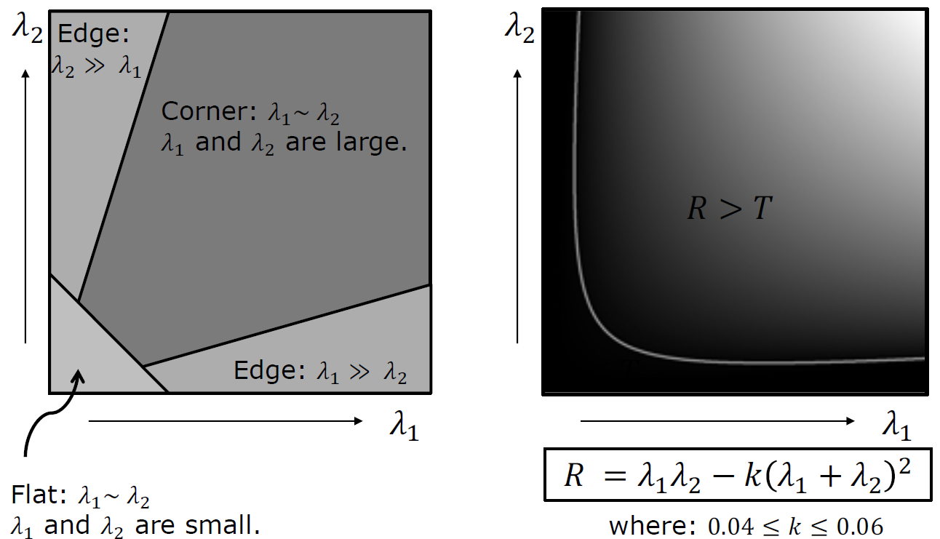
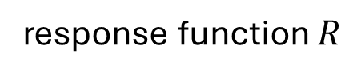
response function $R$
alternative:
use the smaller eigenvalue as response function
use threshold on eigenvalues for corner detection
perform non-maximum suppression

Slide 27
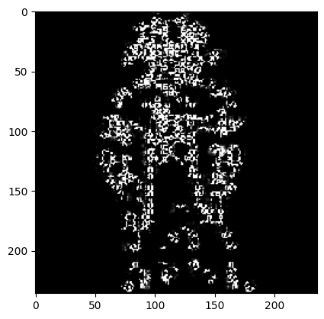

response function:
thresholded response:

Slide 28



corner response rotation invariant
but not scale invariant
eigenvalues stay the same
important for detection in images with different sizes or at positions with different depths
corner!
edge!

Slide 29

Scale-Invariant Keypoint Detection
→ need to detect keypoints at the right scale for each image
→ search for both position and scale

Slide 30


Additional Keypoint-Detection Requirements
corners often not descriptive enough for complex objects (e.g., smoother regions)
→ need to detect not only corners, but all kinds of blobs (keypoint as center of blob region)
and it must be possible to find the right scale for the blob to be detected:
response of blob detector

Slide 31







LoG Operator
$$f\left(x\right)$$
$$n_{σ}$$
$$\frac{d^{2}n_{σ}}{dx^{2}}$$
$$\frac{d^{2}n_{σ}}{dx^{2}}∗f\left(x\right)$$
$$σ^{2}\frac{d^{2}n_{σ}}{dx^{2}}∗f\left(x\right)$$

Slide 32









Detect Blobs at Different Sizes
$$f\left(x\right)$$
example: LoG filter for $σ=1.4$
$$n_{σ}$$
$$\frac{d^{2}n_{σ}}{dx^{2}}$$
$$\frac{d^{2}n_{σ}}{dx^{2}}∗f\left(x\right)$$
need larger filter for larger $σ$
→ need to compute this at many scales
$$σ^{2}\frac{d^{2}n_{σ}}{dx^{2}}∗f\left(x\right)$$

Slide 33




$$σ$$
multiple scales via Gaussian filters with different $σ$

Slide 34









DoG as Approximation of LoG
just apply Gaussian filters
$$\sqrt{2}$$
$$k=4$$
$$k=3$$
approximation of NLoG responses at different scales
$$k=2$$
$$k=1$$
$$k=0$$
NLoG

Slide 35




Scale Invariant Feature Transform (SIFT) Detector
look at $3×3×3$ neighborhoods
detected keypoints with different scales
detect as keypoint if center is extrema in this pixel-scale volume

Slide 36


Gaussian Pyramid for Different Image Sizes
scale
downsampling (half size)

Slide 37
Feature Description & Matching

Slide 38
Motivation
feature descriptor:
simplified representation of an image containing only its most important information
raw pixel intensities difficult to interpret
(→ deep learning)

Slide 39
Local Patches as Features
extract patches around keypoints
→ descriptor: vector summarizing content of these patches
simplest descriptor: just raw intensity values of pixels in patch (template matching)
but need to be invariant to translation, rotation, scale, (illumination)

Slide 40






SIFT Descriptor
rotation invariance:
rotate gradients relative to the keypoint’s principal orientation before calculating the descriptor
$16×16$ square window around detected keypoint
($8×8$ shown here for visualization)
SIFT descriptor is vector of length $128$:
$4×4$ histograms per keypoint
$8$ orientation bins per histogram
weighted by Gaussian fall-off function
using the image of the detected scale (i.e., smoothed with corresponding Gaussian filter) for this keypoint

Slide 41


Many Other Feature Detectors/Descriptors
MOPS: simple normalized intensity patches
SURF, ORB: similar to SIFT, but faster
HOG: used for larger image regions, particularly suited for human detection
…
Multi-scale Oriented PatcheS:
Histogram of Oriented Gradients:
counting occurrences of gradient orientations in localized portions of an image
features covering entire image
(instead of just local patches)

Slide 42


Feature Matching
goal: for each keypoint in a given image, find nearest neighbor in other image
(or rank different potential matches)
→ look for smallest distance $d$ between the corresponding feature descriptors $f$ (vectors) in image $1$ and $2$
several possible distance metrics, e.g., L2:
$$d=\sqrt{{\left(f_{1}−f_{2}\right)}^{2}}$$
image alignment: homography ...

Slide 43

Object Recognition
using SIFT features
two database images to be recognized:
approach: extract features and compare against stored object features in database (successful if defined number of feature matches found), subsequent match verification by geometric alignment
works well for instance recognition (e.g., specific car), but class recognition (e.g, cars in general) requires more abstraction → ML

Slide 44


Slide 45

Facial Recognition with Eigenfaces
now dominated by deep learning models
alternative approach for instance recognition: eigenimages
most popular example: individual face images expressed as combination of basis images (called eigenfaces)
PCA (unsupervised ML) on large training set of face images, use principal components (eigenvectors with largest eigenvalues) as basis images
identification: compare vectors of eigenface components (projections to eigenspace), typically using ~100 eigenfaces
some eigenfaces:

